Slide 1
Evaluate the skew of the curve
16-08-2016

Slide 2
Scoring the genome
Uptake bias PSSM
 | V1 | V2 | V3 | V4 | V5 | V6 | V7 | V8 | V9 | V10 | V11 | V12 | V13 | V14 | V15 | V16 | V17 | V18 | V19 | V20 | V21 | V22 | V23 | V24 | V25 | V26 | V27 | V28 | V29 | V30
a | 0.071 | 0.094 | 0.423 | 0.632 | -0.130 | -0.127 | -0.073 | -0.064 | -0.066 | -0.097 | -0.106 | -0.013 | 0.147 | 0.070 | 0.044 | 0.035 | -0.021 | -0.055 | -0.021 | 0.004 | 0.001 | -0.002 | -0.013 | -0.003 | 0.050 | -0.006 | 0.038 | -0.059 | -0.062 | -0.035
c | -0.092 | -0.035 | -0.125 | -0.119 | -0.112 | -0.122 | -0.100 | 1.857 | -0.088 | -0.116 | -0.030 | 0.052 | -0.066 | -0.047 | -0.076 | -0.081 | -0.036 | 0.013 | -0.018 | -0.007 | 0.008 | 0.002 | 0.001 | 0.013 | -0.060 | -0.042 | -0.097 | -0.011 | -0.028 | -0.008
g | 0.058 | -0.019 | -0.032 | -0.071 | 1.010 | -0.127 | 1.607 | -0.055 | 1.765 | 1.573 | -0.104 | -0.061 | 0.028 | 0.002 | -0.061 | -0.114 | -0.113 | -0.080 | -0.025 | 0.000 | 0.011 | 0.006 | 0.010 | -0.004 | 0.063 | -0.056 | -0.126 | -0.121 | -0.076 | -0.030
t | -0.009 | -0.027 | -0.085 | -0.065 | -0.119 | 0.831 | -0.125 | -0.054 | -0.082 | -0.112 | 0.398 | 0.034 | -0.070 | -0.016 | 0.129 | 0.268 | 0.262 | 0.165 | 0.071 | 0.003 | -0.020 | -0.006 | 0.002 | -0.005 | -0.038 | 0.128 | 0.348 | 0.316 | 0.228 | 0.084
max | 0.071 | 0.094 | 0.423 | 0.632 | 1.010 | 0.831 | 1.607 | 1.857 | 1.765 | 1.573 | 0.398 | 0.052 | 0.147 | 0.070 | 0.129 | 0.268 | 0.262 | 0.165 | 0.071 | 0.004 | 0.011 | 0.006 | 0.010 | 0.013 | 0.063 | 0.128 | 0.348 | 0.316 | 0.228 | 0.084

Slide 3
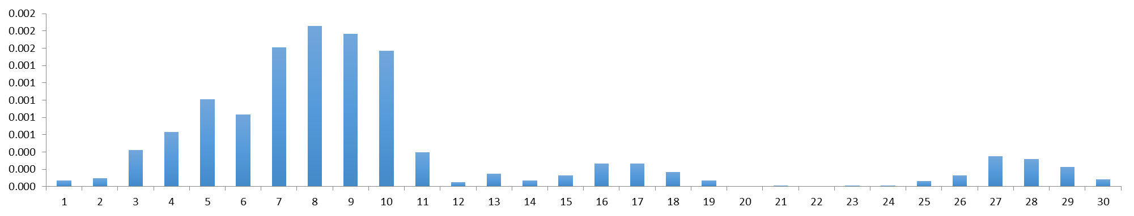
1 2 3 4 5 6 7 8 9 10 11 12 13 14 15 16 17 18 19 20 21 22 23 24 25 26 27 28 29 30
30 29 28 27 26 25 24 23 22 21 20 19 18 17 16 15 14 13 12 11 10 9 8 7 6 5 4 3 2 1

Slide 4
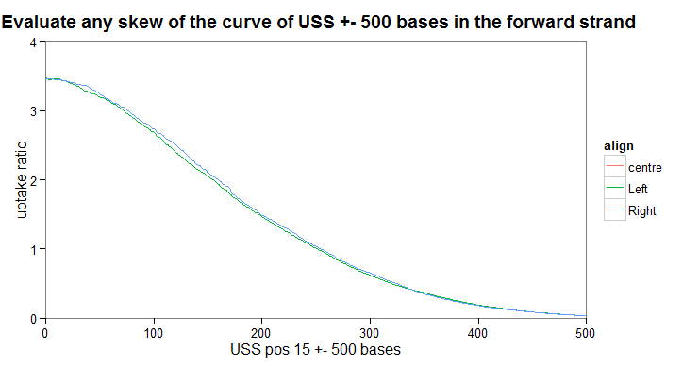
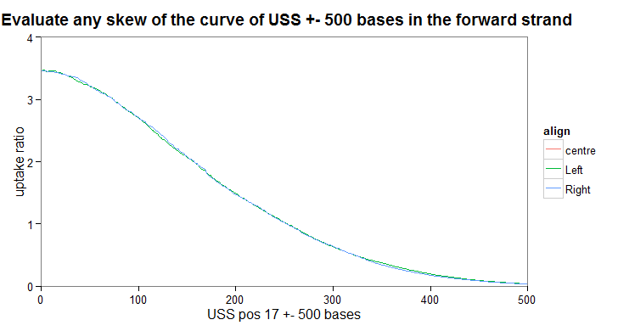
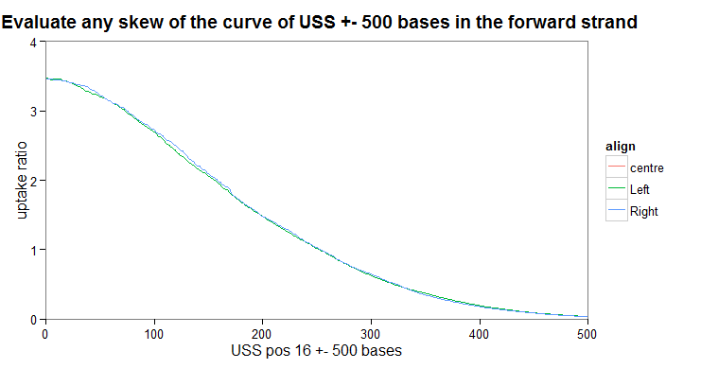
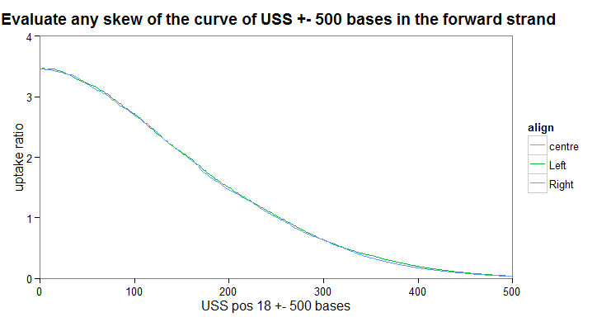

Slide 5
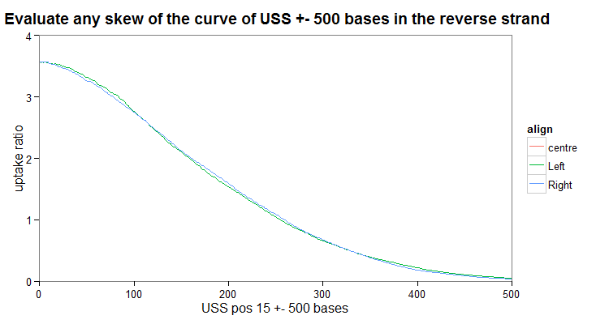

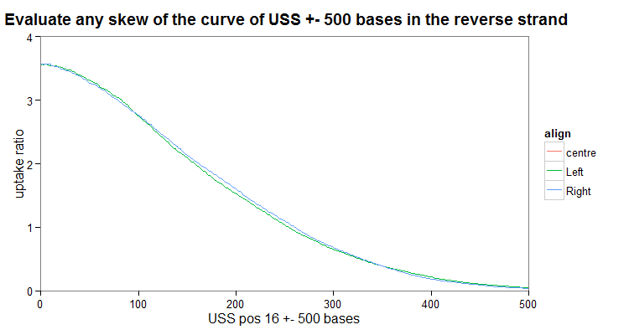
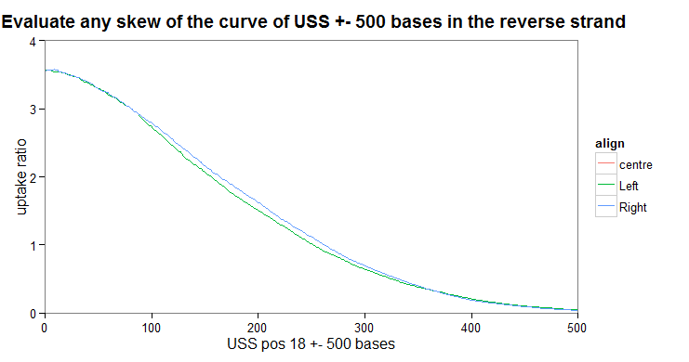

Slide 6
1 2 3 4 5 6 7 8 9 10 11 12 13 14 15 16 17 18 19 20 21 22 23 24 25 26 27 28 29 30
Centre of forward strand
Centre of reverse strand
30 29 28 27 26 25 24 23 22 21 20 19 18 17 16 15 14 13 12 11 10 9 8 7 6 5 4 3 2 1

